Slide 1
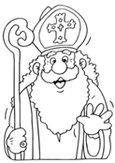
Weihnachten Wörter
Look at the Christmas words worksheet. (put in your binder under Vokabeln)
Use the 2nd sheet to cut out the pictures. Glue them to a white sheet of paper – create a Christmas scene! You must use at least 10 pictures.
Picture needs to be colored and each vocab word used should be labeled.
Put your name & period on the back.
Due Tomorrow at the end of class!

