Slide 1
ein Weihnachtslied auf Deutsch

Slide 2
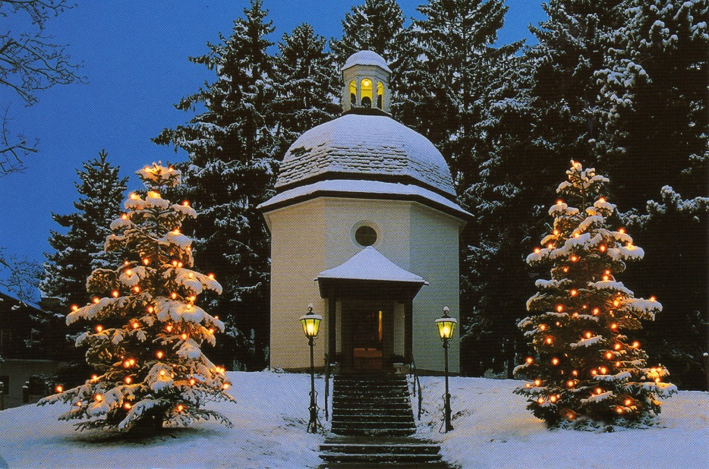
Die “Stille Nacht” von 1818
In 1818, a band of actors was performing in towns throughout the Austrian Alps. On December 23 they arrived at Oberndorf, a village near Salzburg where they were to perform the story of Christ's birth in the small Church of St. Nicholas.
As pastor Josef Mohr left the Christmas celebration, he took a longer path home which took him up over a hill overlooking the village.
From that hilltop, Mohr looked down on the peaceful snow-covered village. His thoughts about the Christmas play suddenly made him remember a poem he had written a couple of years before: A poem about the night when angels announced the birth of the long-awaited Messiah to shepherds.

Slide 3
Mohr decided those words would make a good carol for his congregation the following evening at their Christmas Eve service.
However, he didn't have any music to sing the poem. The next day Mohr went to see the church organist, Franz Gruber. Gruber put guitar music to the song. The song became a hit.
On Christmas Eve, the little Oberndorf congregation heard Gruber and Mohr sing their new composition to the accompaniment of Gruber's guitar.
Weeks later, well-known organ builder Karl Mauracher arrived to fix the St. Nicholas church organ. When he finished, Mauracher stepped back to let Gruber test the instrument.
When Gruber sat down, his fingers began playing the simple melody he had written for Mohr's Christmas poem. Deeply impressed, Mauracher took the music and words of “Stille Nacht" back to his own Alpine village, Kapfing. There, two well-known families of singers -- the Rainers and the Strassers -- heard it. Captivated by “Stille Nacht," both groups added the song to their Christmas carols.
Eventually the song began spreading throughout Europe, first with King Frederick William IV of Prussia, who ordered his cathedral choir to sing it every Christmas Eve. The Rainers brought it to America.

