Slide 1
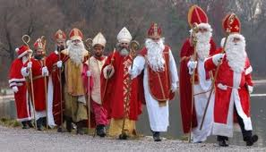
Nikolaustag
December 6

Slide 2
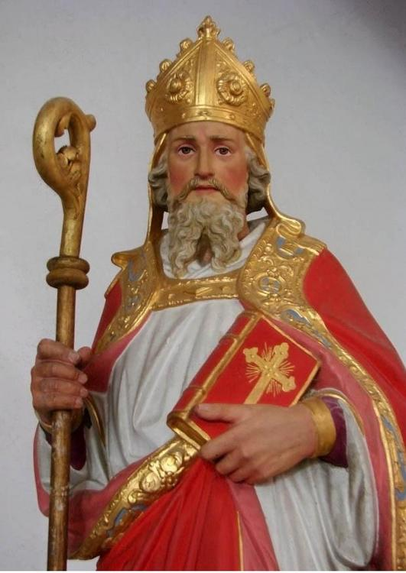
Wer war Sankt Nikolaus?
Nikolaus of Myra was born 15 March 270 and died 6 December 343 at the age of 73 in what is now Turkey.
His wealthy parents died when he was young. He gave up his inheritance to help the poor and dedicated his life to serving God and others. He became a saint because of his work with the poor and needy as well as children.

Slide 3
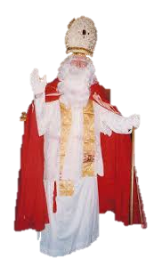
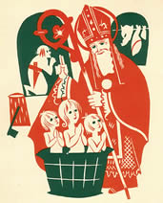
Wer war Sankt Nikolaus?
One legend tells how during a terrible famine, a malicious butcher lured three little children into his house, where he killed them in order to sell them off as ham. Saint Nicholas, visiting the region to care for the hungry, not only saw through the butcher's horrific crime but also resurrected the three boys from the barrel by his prayers.
He is considered the patron saint of children.

Slide 4
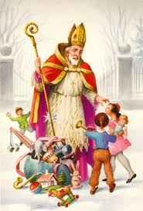
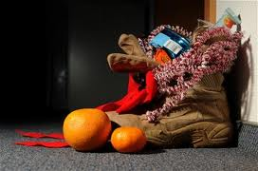
St. Nikolaus had a reputation for secret gift-giving, such as putting coins in the shoes of those who left them out for him.
Now, on December 5th, children leave their shoes outside the door, and awaken to find them filled with oranges, chocolates, and goodies.

Slide 5
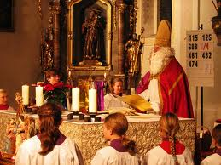
St. Nikolaus visits children at home – he comes right to the front door! – and reads to them from a large golden book…
Grüß Gott, ihr Kinder hier im Haus!
Hört zu: Ich bin St. Nikolaus!
Habt keine Angst, shaut mich nur an-
ich bin kein wilder fremder Mann.
Den Sack hier hab' ich mitgebracht,
da drin steckt, was euch Freude macht!
Hello, children here in the house! Listen: I’m am Saint Nikolaus! Don’t be afraid, just look at me, I’m no wild, strange man. This sack here I brought, what’s inside will make you happy!

Slide 6
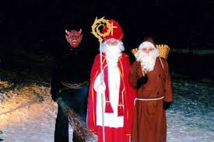
But St. Nikolaus doesn’t visit the children alone….
Each German-speaking country has it’s own “companion”….

Slide 7
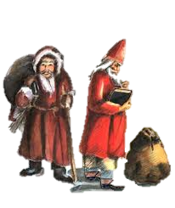
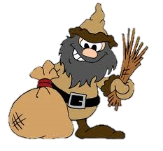
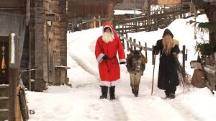
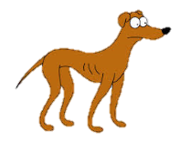
Knecht Ruprecht - Germany
In Germany, St. Nikolaus travels with his companion Knecht Ruprecht.
According to tradition, Knecht Ruprecht asks children whether they can pray. If they can, they receive apples, nuts, and gingerbread. If they cannot, he beats the children with his bag of ashes.
Knecht Ruprecht gives naughty children useless, ugly gifts such as lumps of coal, sticks, and stones, while well-behaving children receive sweets from Saint Nicholas. He also can be known to give naughty children a switch (stick) in their shoes for their parents to beat them with, instead of candy, fruit and nuts, in the German tradition.
In the german version of The Simpsons, the dog “Santa’s Little Helper” is named Knecht Ruprecht.

Slide 8
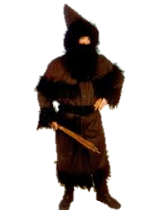
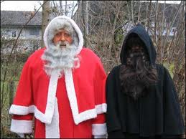
Schmutzli - Switzerland
Schmutzli is St. Nikolas’s companion in Switzerland.
Schmutzli means “dirty” in Swiss German.

Slide 9
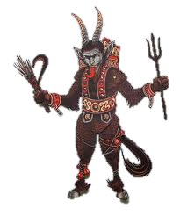
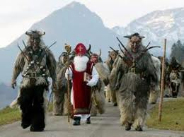
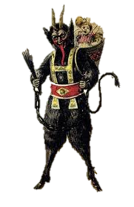
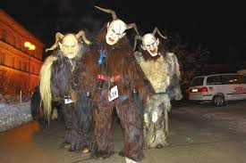
Krampus – Austria
In Austria and Switzerland, Krampus visits children on Dec. 5th with St. Nikolaus. Compared to Knecht Ruprecht, he’s very SCARY.
Like his German counterpart, Krampus is the “bad-cop”… he snatches up naughty children and beats them with sticks or kidnaps them to his lair.
Krampus is often a beast-demon figure who carries chains and sometimes bells.
In many Austrian towns, the night of Dec. 5th there is a Krampuslauf – a parade of men dressed as Krampus.

Slide 10
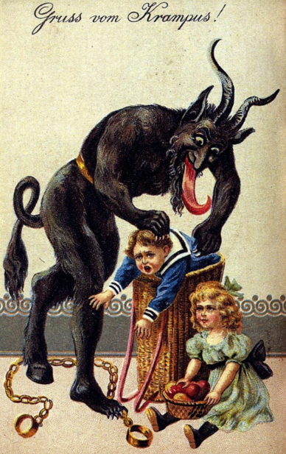
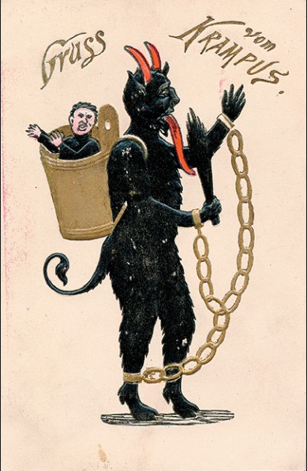
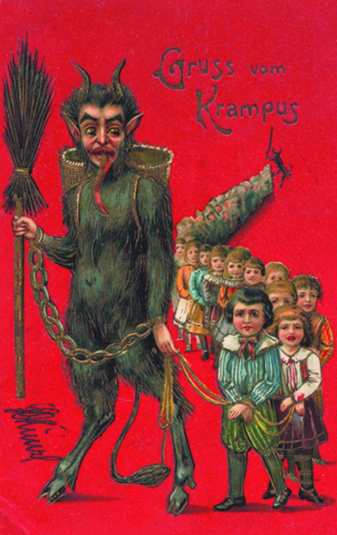
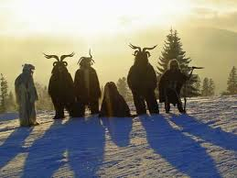
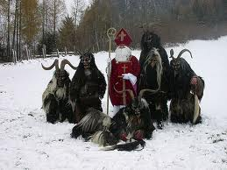
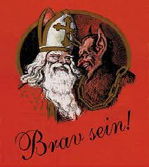
There are many Krampus themed greeting cards!

